Slide 1
Capstone 2
Analyze Hand Gestures
Slide Deck
Bogdan Sburlea - May 30th, 2020

Slide 2
OBJECTIVE:
Create a machine learning model that authenticates a real user
in front of a camera. The model must recognize 5 gestures that a
user can make.

Slide 3
Data acquisition problem
How to get thousands of labeled data per class for training purposes?
Solution
I recorded a video of myself showing gestures for each class
for an equal amount of time.
The video was divided into frames and the frames were labeled
based on their timestamp.

Slide 4
Data cleaning
I needed to eliminate the frames that were close to beginning or the end
Of a switch between gestures. I eliminated several such batches of frames that
could have created a mixture of gestures for a certain training class.
The remaining frames were rescaled to 255x255x3 numpy arrays
for the training and testing classes.

Slide 5
Data Processing
The neural network was trained on a modern Nvidia GPU
running on Ubuntu 18.04.
For increasing the variance, I applied several transformations to the generator
for the images for train and test classes:
no horizontal or vertical shift. The gestures are sometime close to the edge
of the image
convert the 0…255 values for the RGB channels to [0,1] interval
return the image itself and a one-hot encoded class based on the
class directory

Slide 6
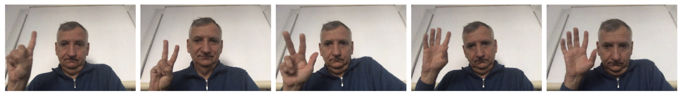
Sample training images
I applied the generator transformations for these images.

Slide 7
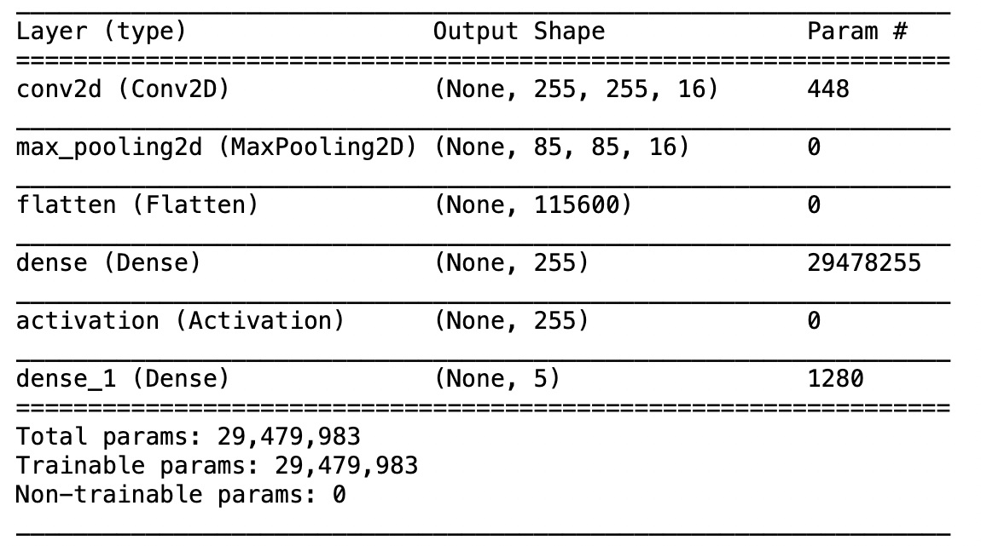
The first tested model:

Slide 8
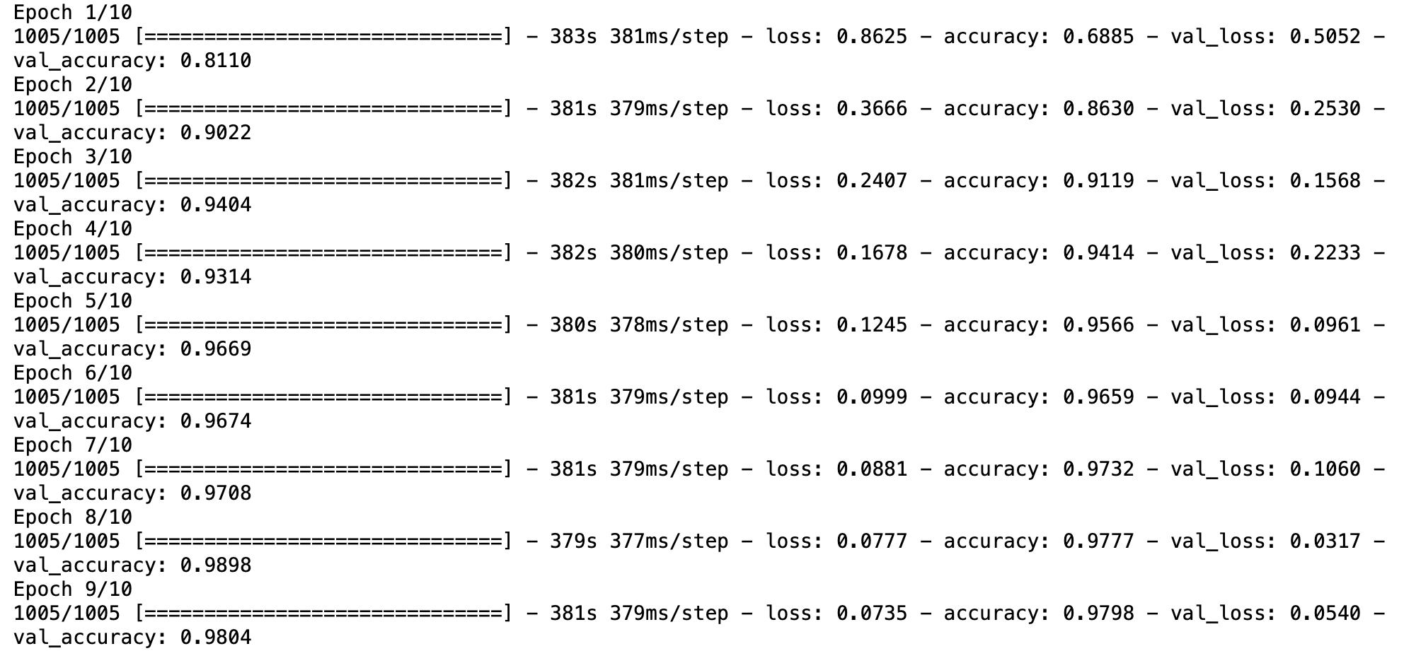

Slide 9
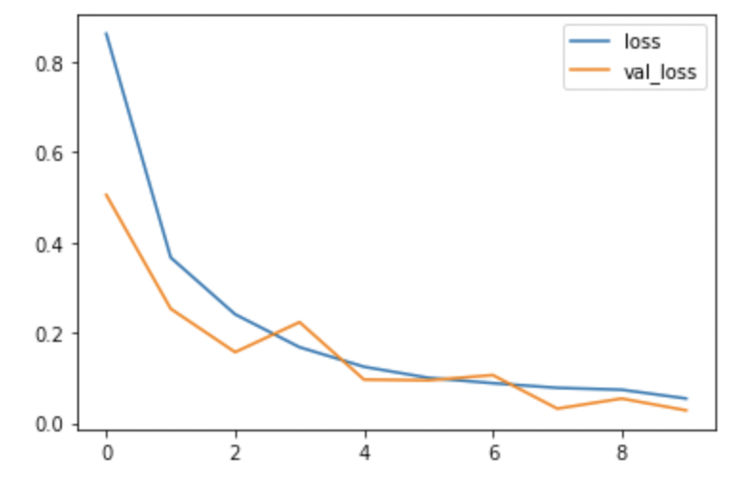
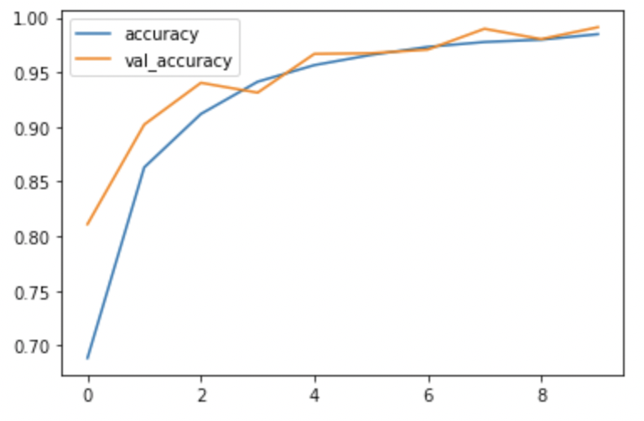
This model has only one convolutional+pooling layer. Even so, the accuracy
was around 98%:

Slide 10
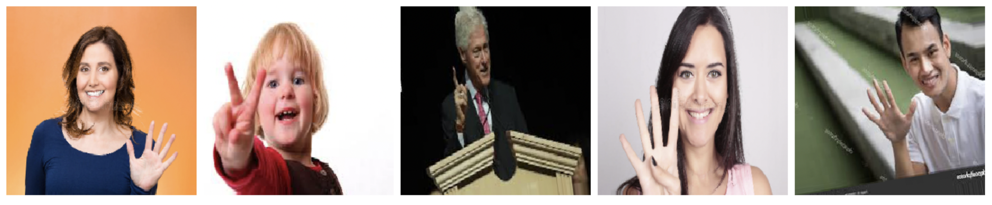
However, the test was done with frames from the same video, without huge variations
from the training frames. The real test is done with Internet images as shown below:
These images are challenging:
the background can be non-uniform
the fingers can overlap with the body
the zoom can be different

Slide 11
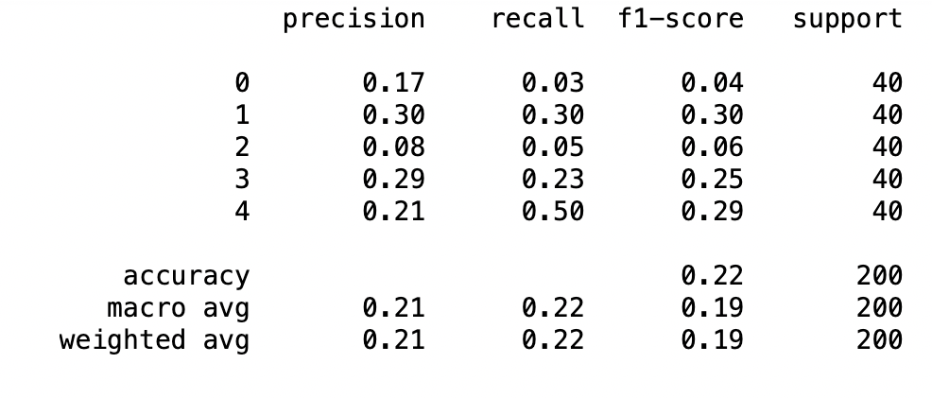
For the Internet images, the results are disappointing:

Slide 12
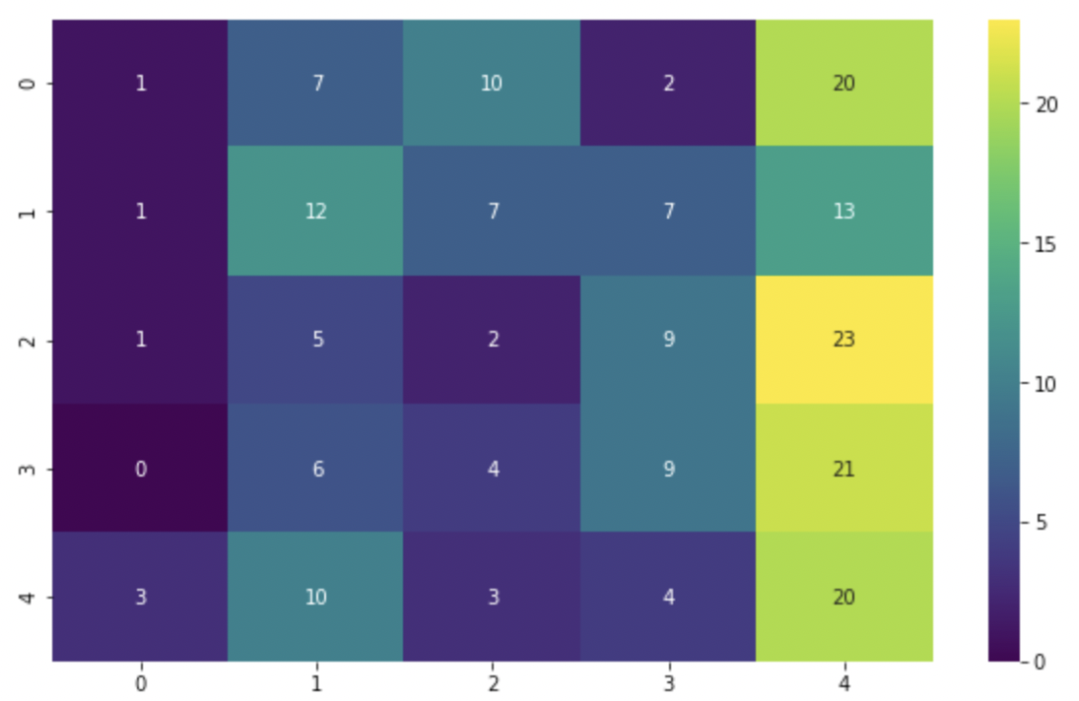
The heat map shows a strong bias towards class 4. The model cannot
decode the features with such complexity as the fingers in an image.
Therefore, I need a new model with more convolutional layers.

Slide 13
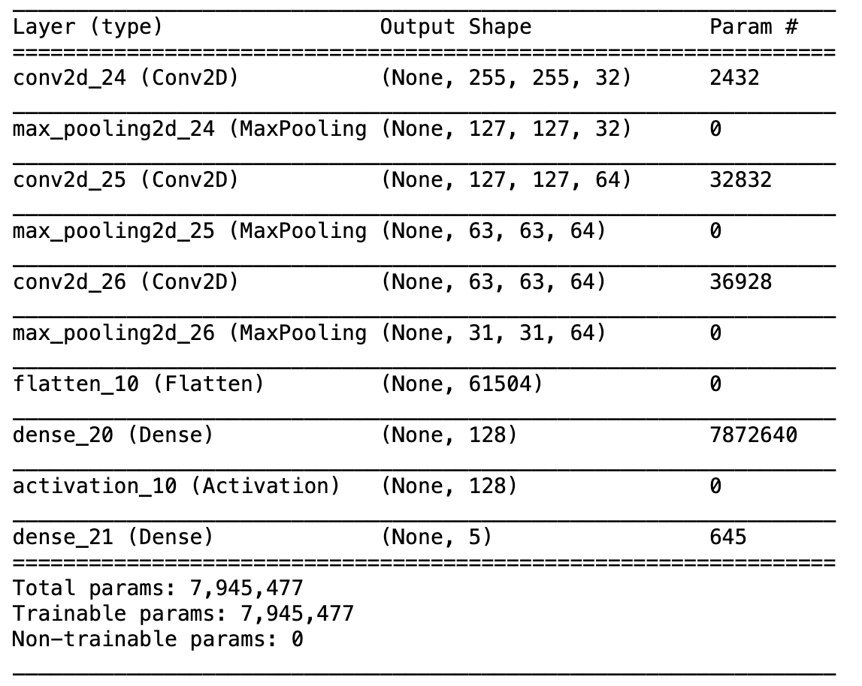

Slide 14
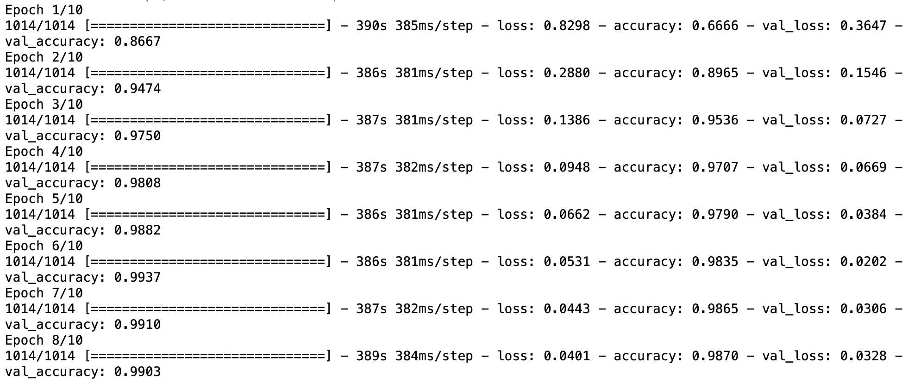
There are now 3 CNN layers with 32, 64, 64 filters
The accuracy becomes 99%.

Slide 15
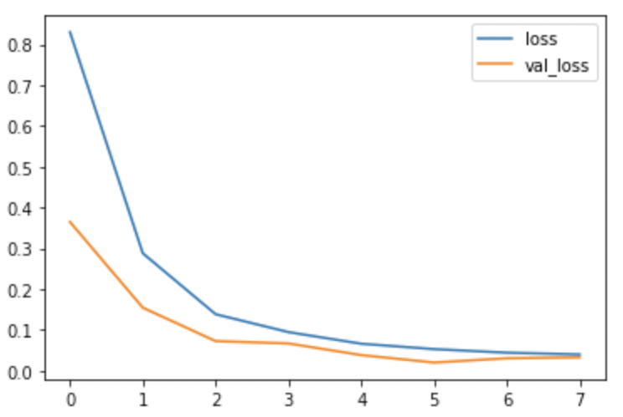
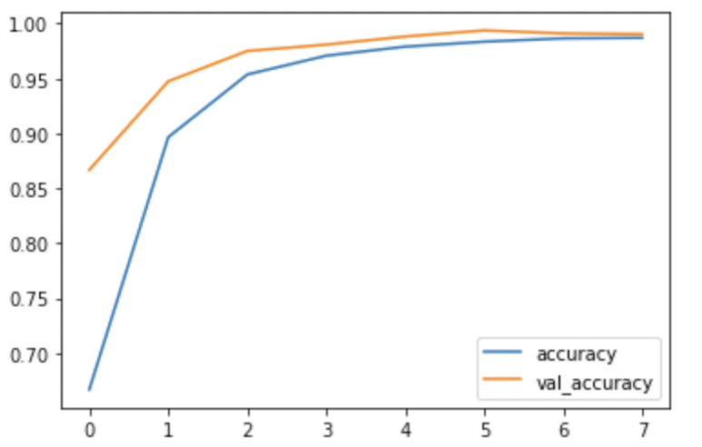
The loss function and the accuracy converge faster to the final values:

Slide 16
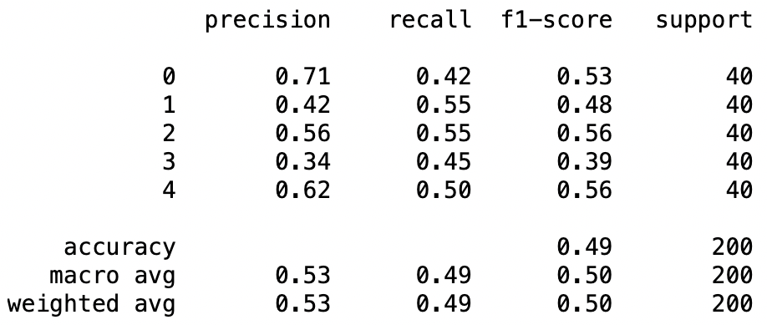
The accuracy is now 49% and all metrics are improved.

Slide 17
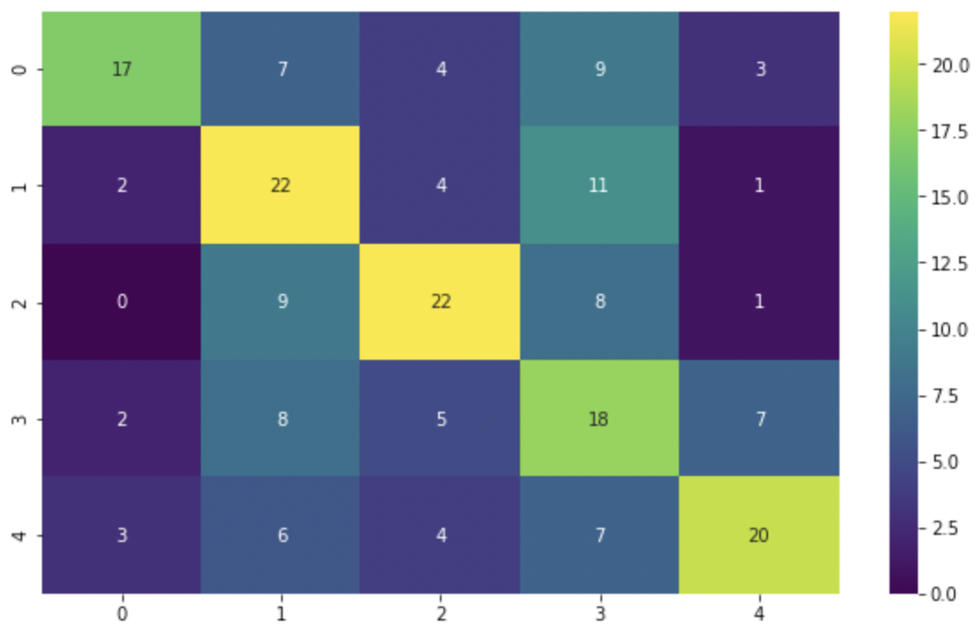
The heat map looks much better, the values on the first diagonal have now
the highest values. There is still a bias towards classes 1 and 3, but that
Issue can be reduced by using more Internet images for training.

Slide 18
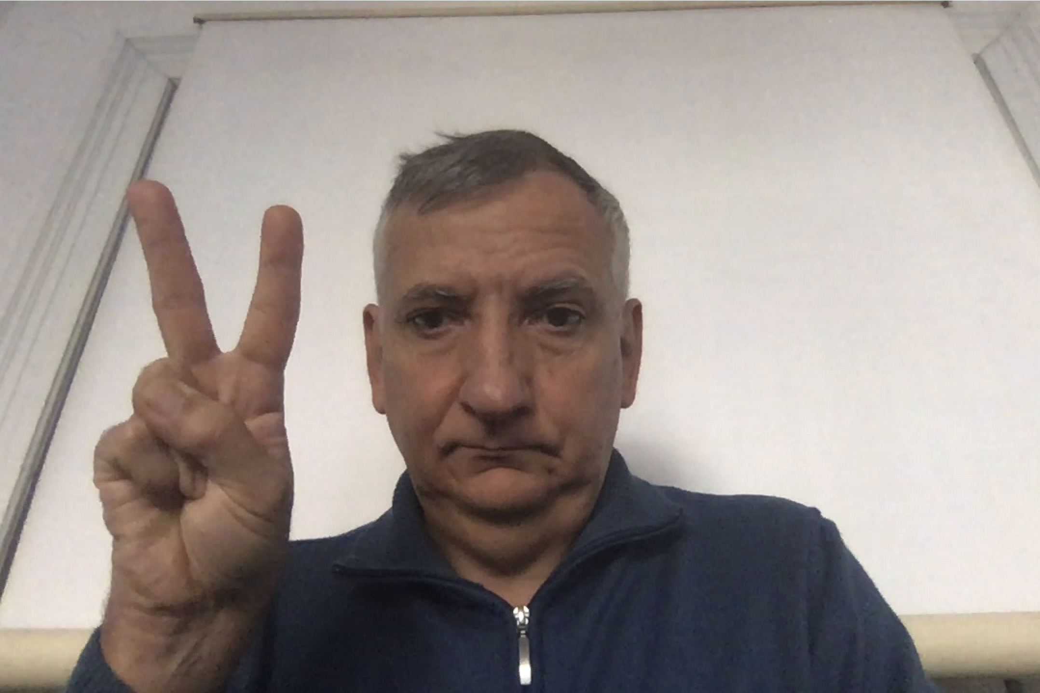
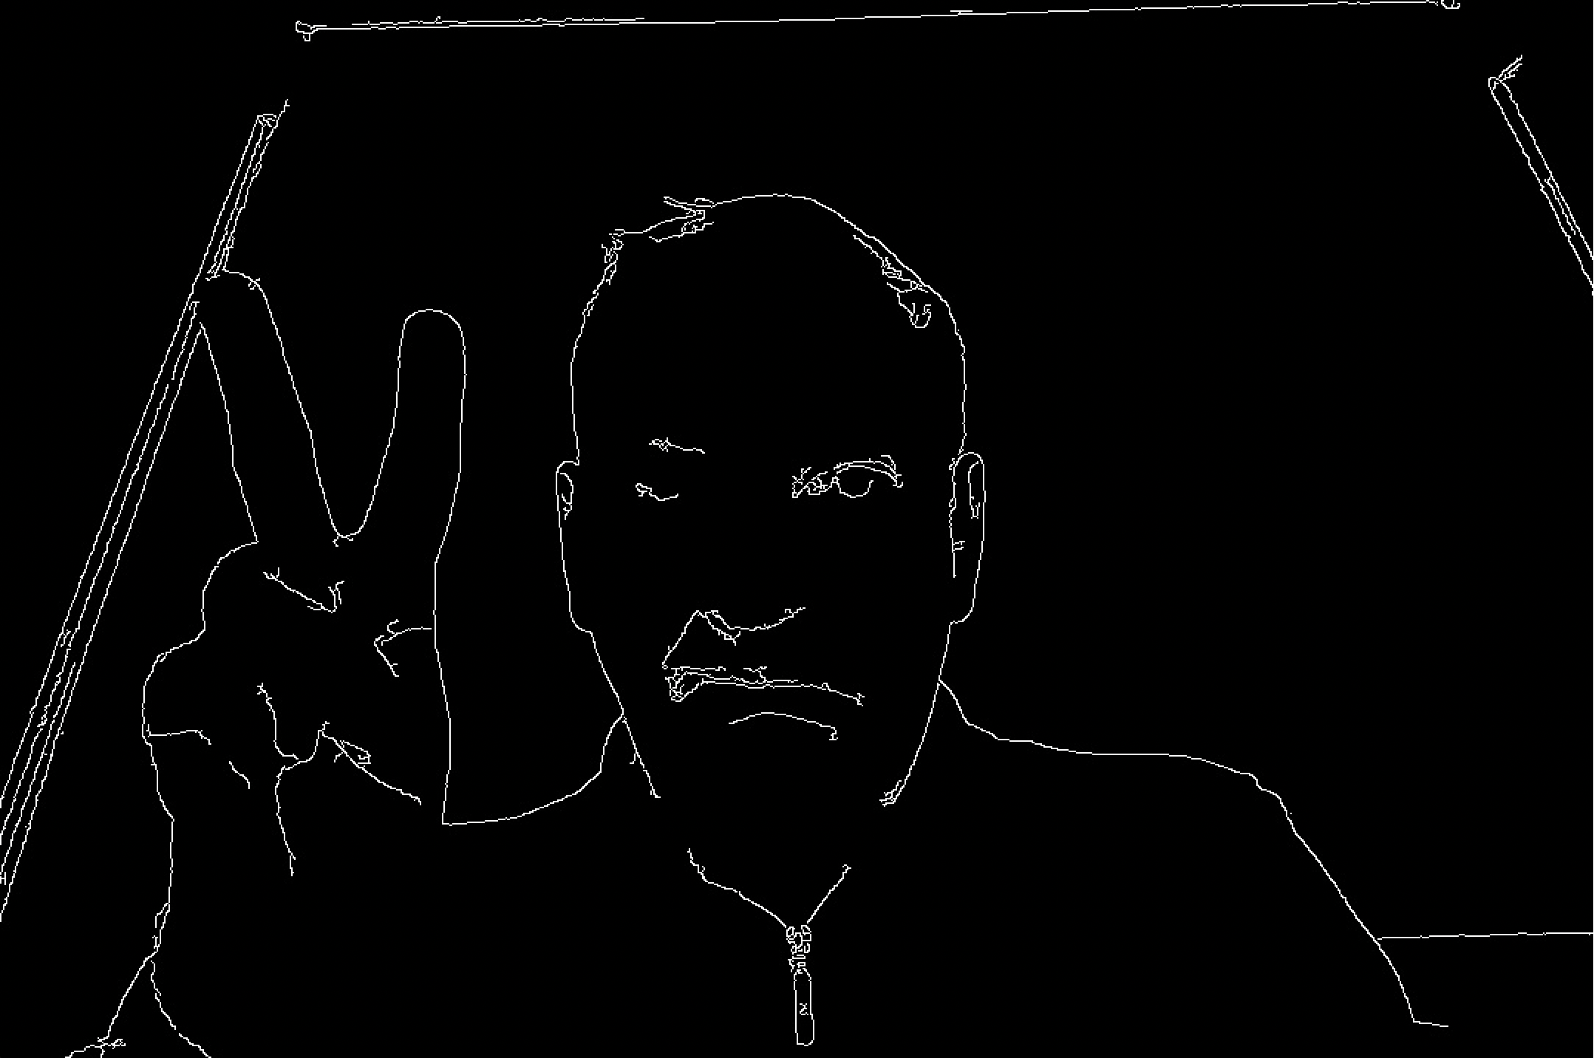
One final try is to use a cv2.Canny() transformation of the input frames,
for eliminating the variance introduced by different backgrounds:

Slide 19
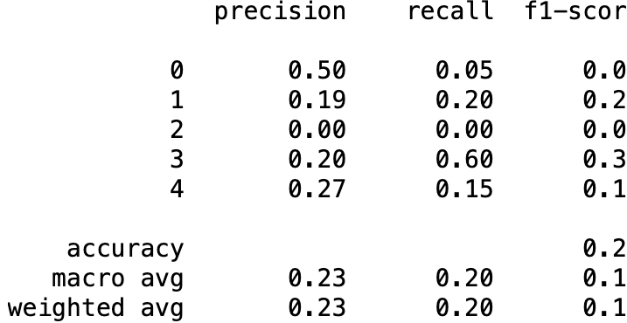
Unfortunately, the results are not satisfactory:
Therefore, the previous model remains the best one.

Slide 20
Ideas for future improvements:
Add more Internet images for train and test classes
Test more CNN structure, with more hidden layers and/or more filters
For allowing a better fit for this complex type of data
Feature extraction: focus only on the hand, ignoring the rest of the image
Apply cv2.Canny() but find a way to tune Canny parameters on the image
characteristics like hue, saturation, value.

Slide 21
Conclusions and next steps
This project proves that it is possible to train a model that recognizes hand gestures
from Internet images.
The model can be deployed using Flask, Docker, Kubernetes or other solutions but
this is outside the scope of this capstone project.

Slide 22
Thank you!

